Slide 1
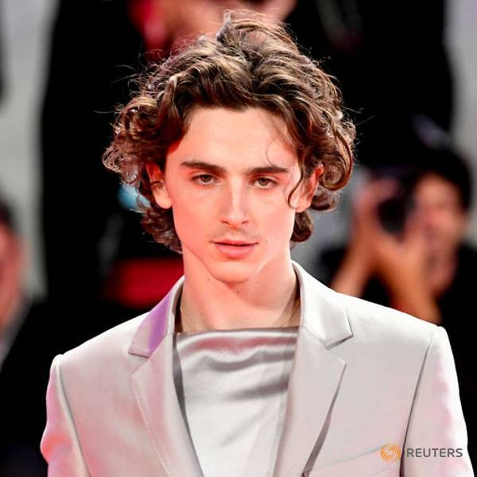
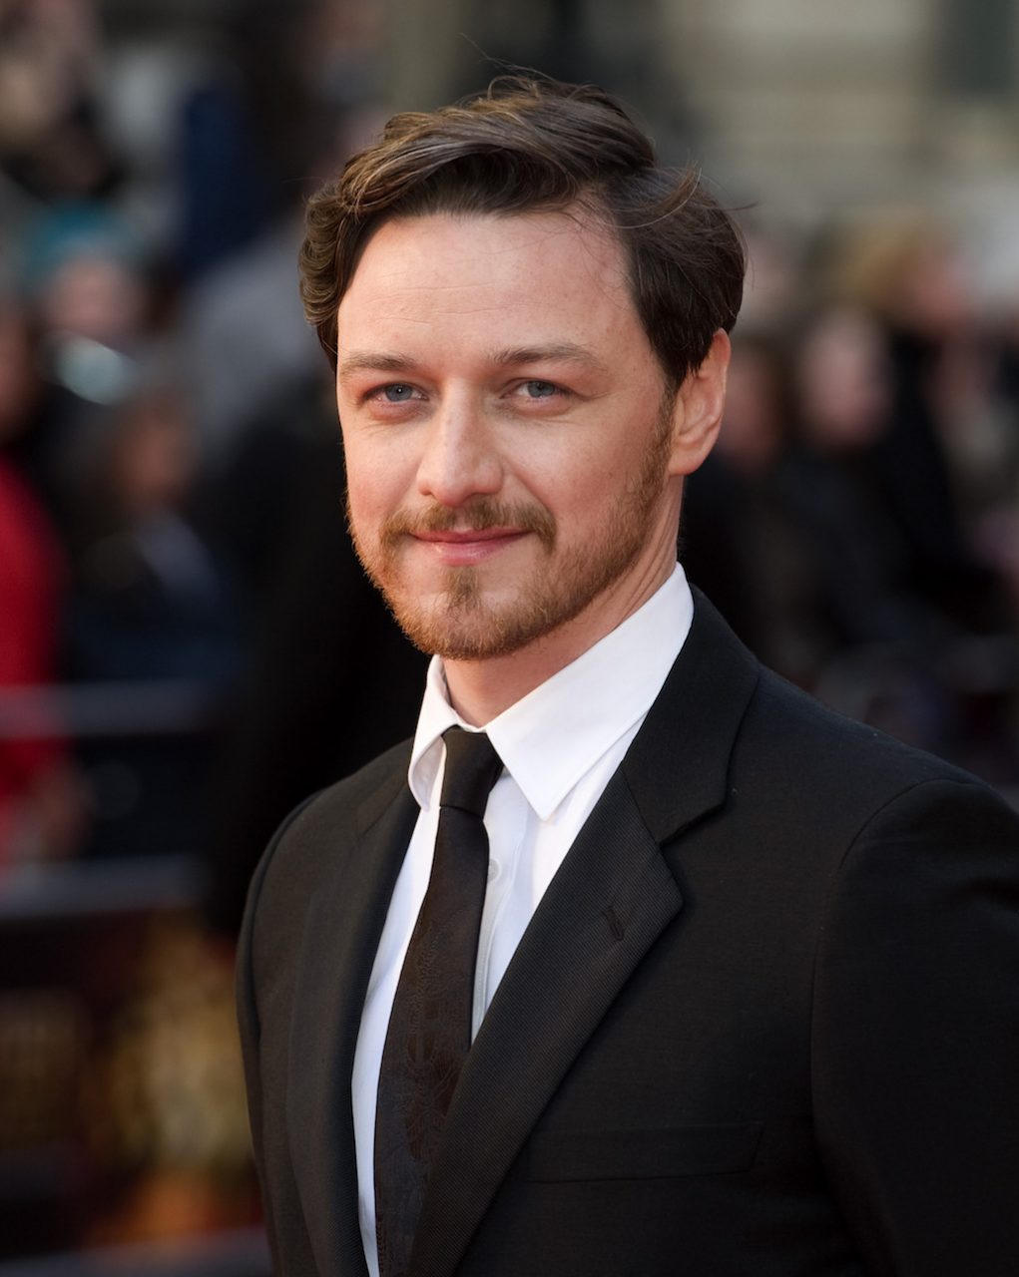
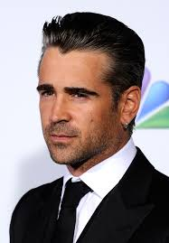
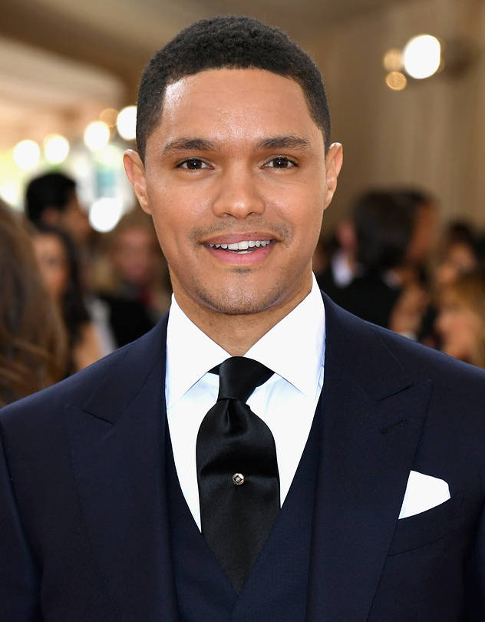

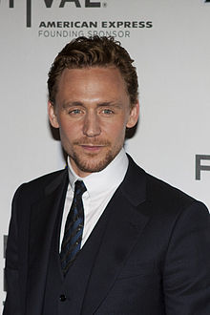

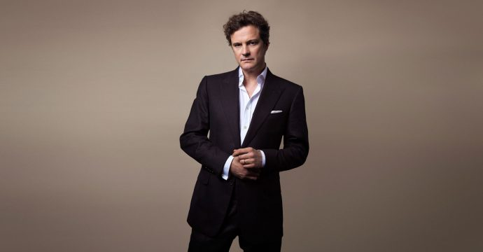

Notes:
Timothee
Reuters
Trevor
https://www.wsj.com/articles/the-daily-show-host-trevor-noah-buys-10-million-penthouse-1488224682
Dan Stevens
https://deadline.com/2019/02/dan-stevens-downton-movie-1202549185/
Andrew Scott
https://www.bbc.com/news/entertainment-arts-49632217
https://www.nme.com/news/fleabag-star-andrew-scott-is-up-for-phoebe-waller-bridges-season-3-plan-2543972
Andrew Garfield
https://www.onthisday.com/people/andrew-garfield

Slide 2





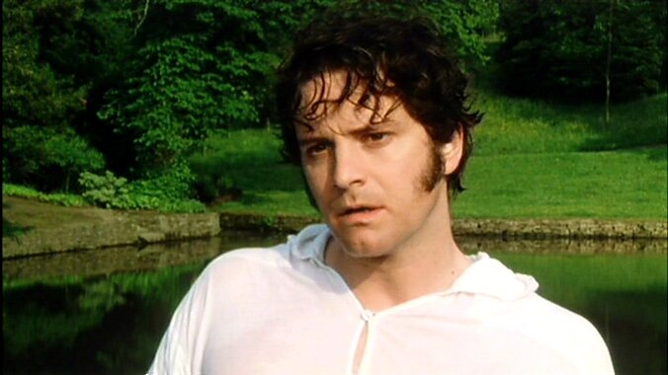



Notes:
Timothee
https://www.cinemablend.com/news/2488195/timothee-chalamet-grew-a-tiny-mustache-and-the-internet-is-freaking-out
Trevor
https://www.wbur.org/hereandnow/2019/06/04/trevor-noah-young-adult-born-a-crime
Andrew Garfield
Andrew Scott
https://twitter.com/andrwscttonline

Slide 3


Notes:
Colin Firth: https://www.thecut.com/2020/02/vanity-fair-oscar-party.html
Dan Stevens: https://www.pinterest.com/pin/AeZLZdwgFzqH7eeCCGZ9vl93O7KniUViIpQ_bOTpyll64xMXKlWq0lE/?nic_v1=1a%2BumqWYj2YGK%2BnLsUlmxwXrr4Dq6HhjPYHOpLusiu6PXovJ30OisxJ9OIsuSa6TOS

Slide 4
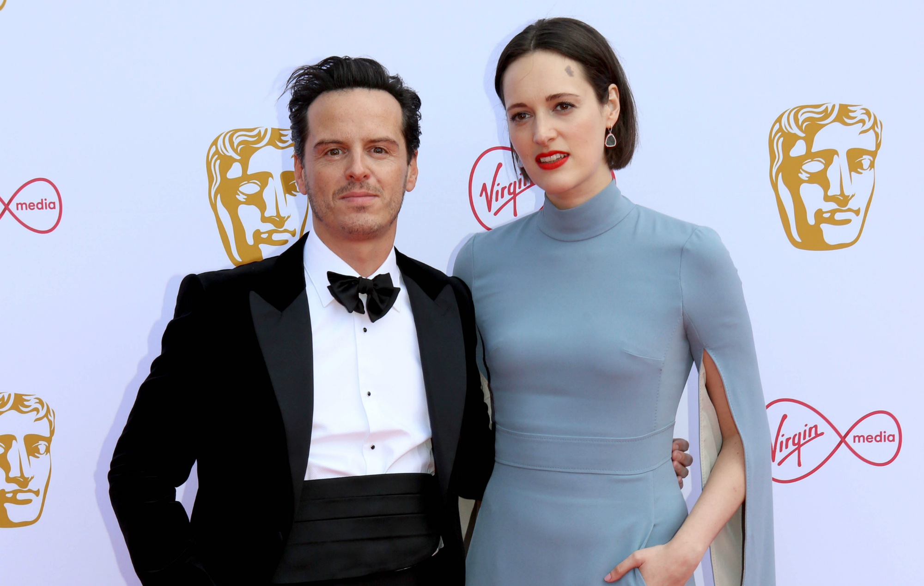

Slide 5
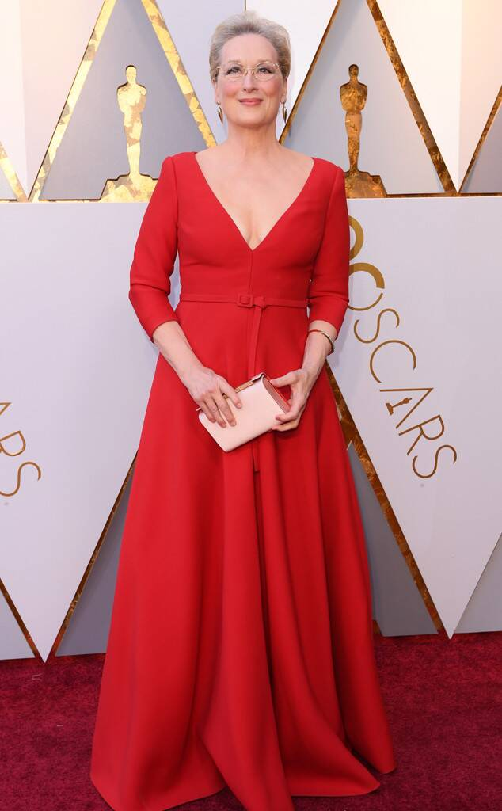

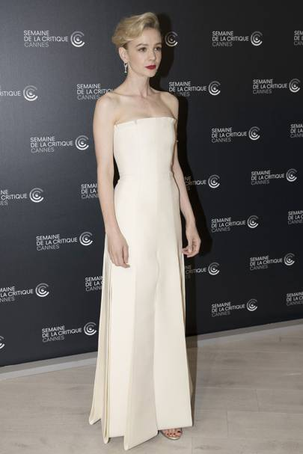
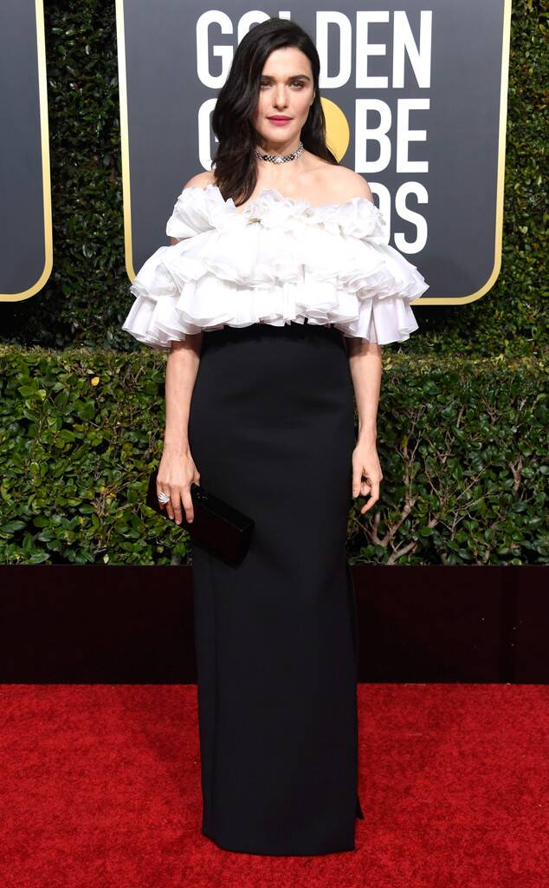
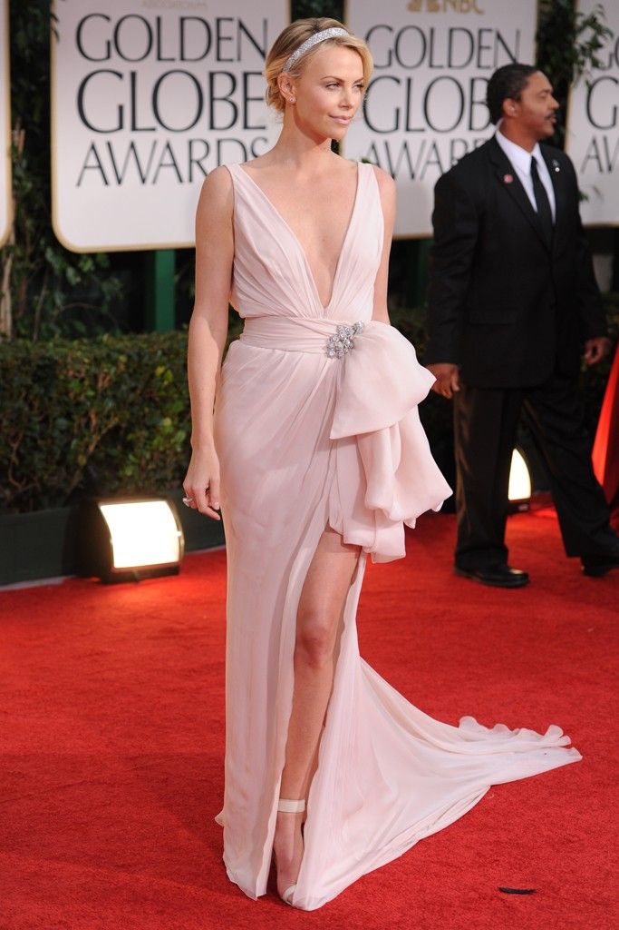
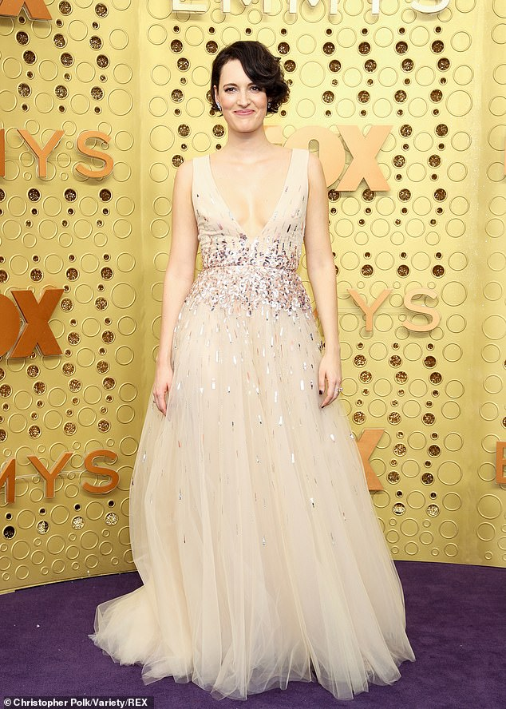
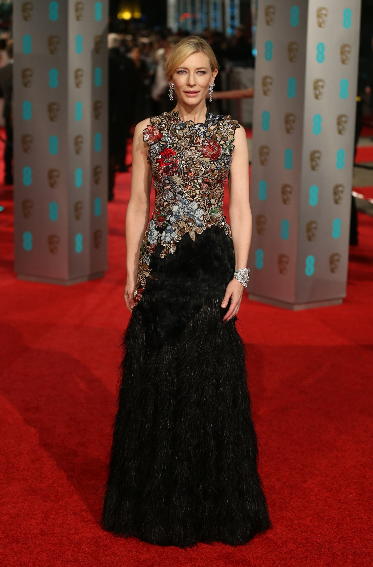
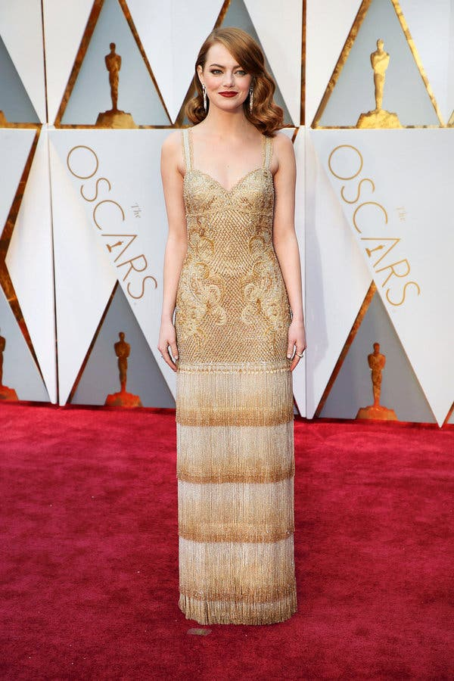
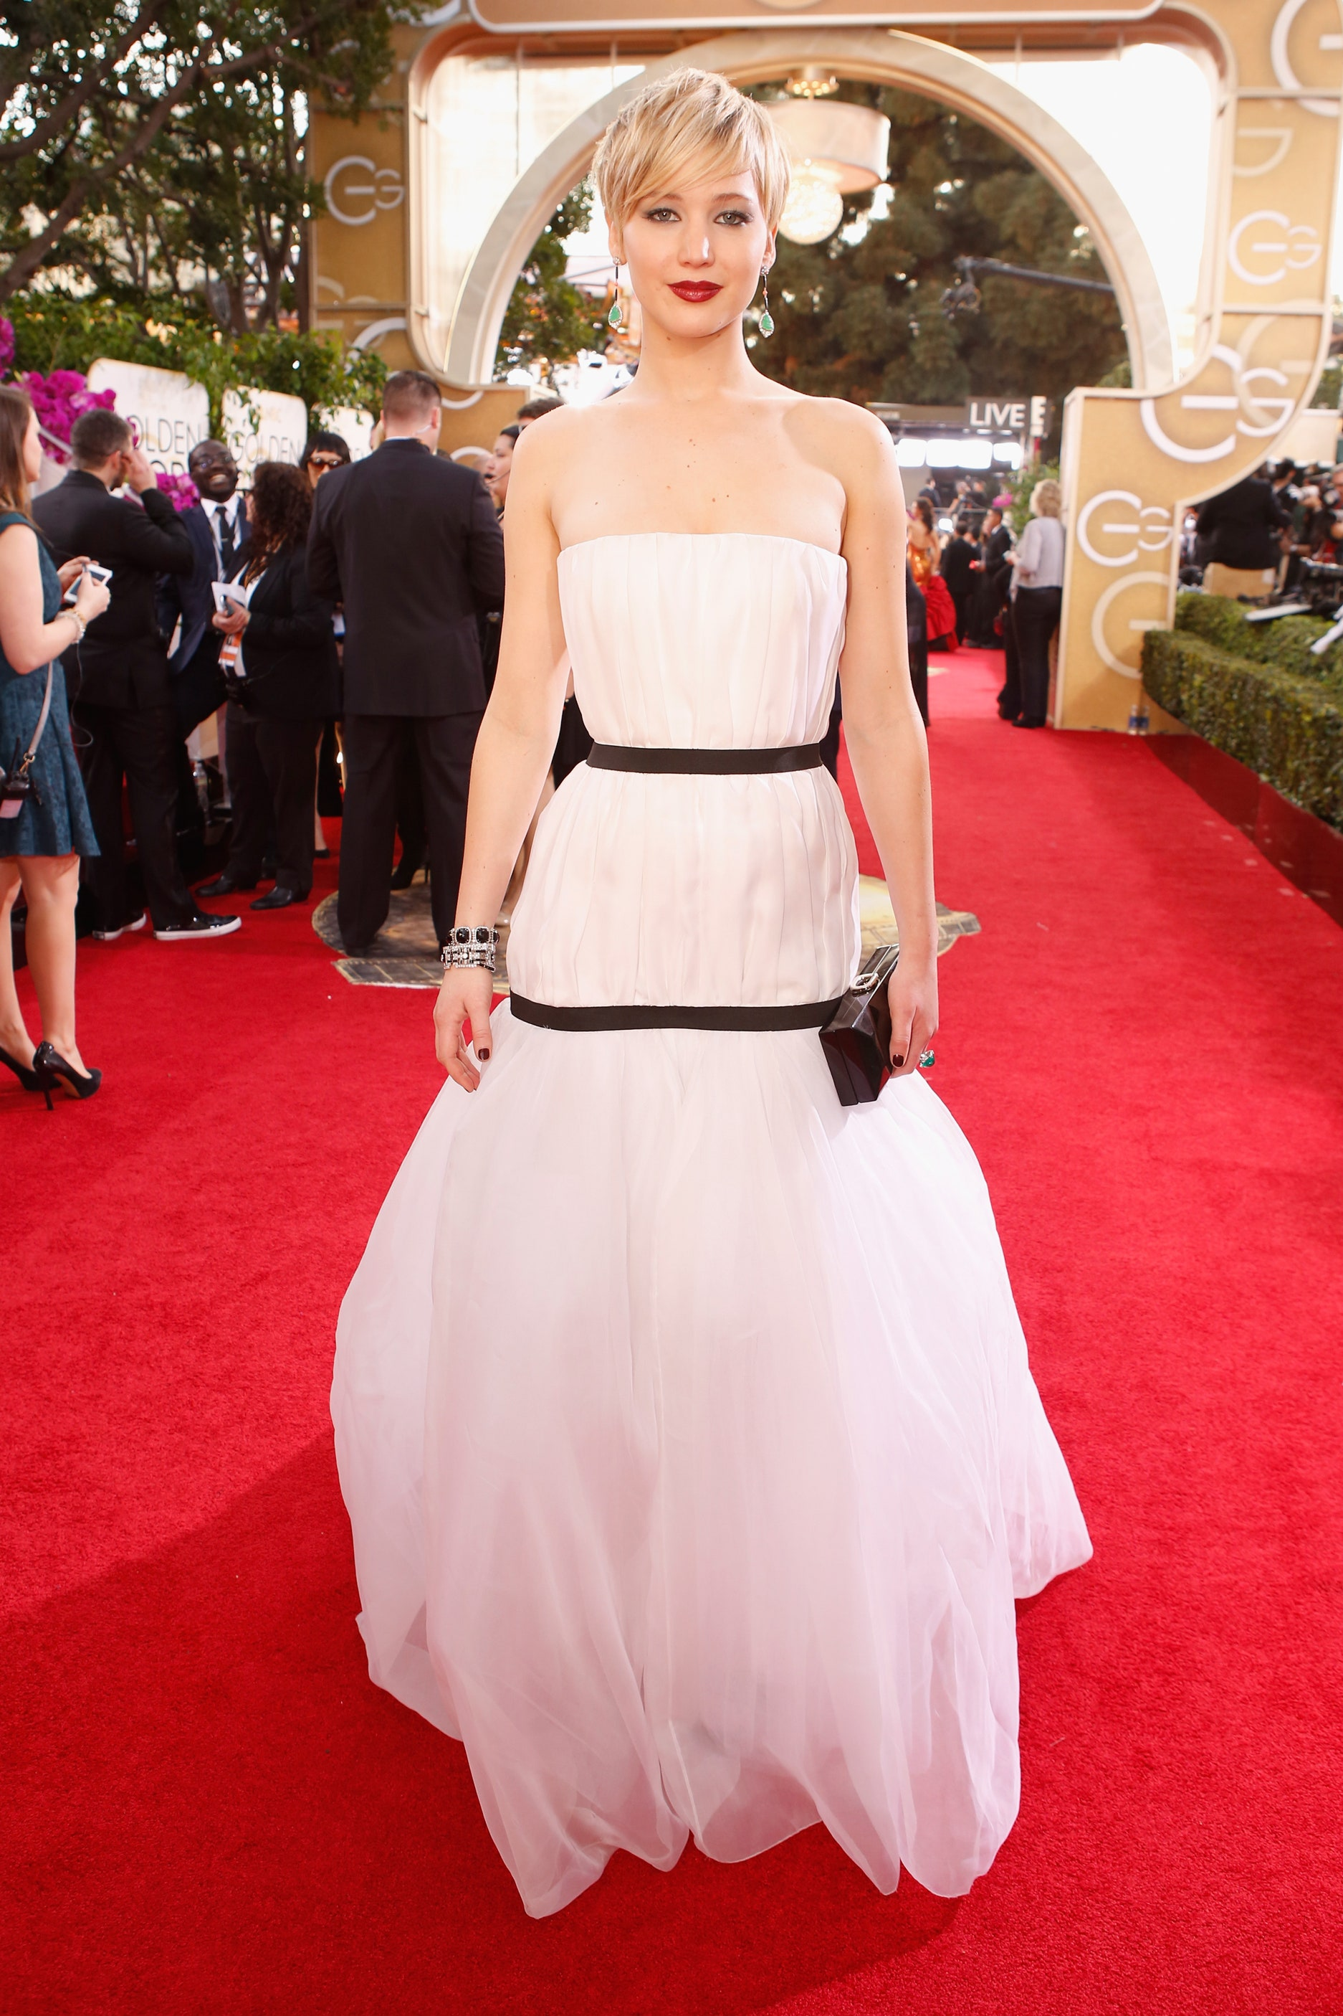
Notes:
Saoirse Ronan:
https://footwearnews.com/2018/fashion/celebrity-style/saoirse-ronan-2018-oscars-lady-bird-red-carpet-style-elizabeth-saltzman-489356/
Rachel Weisz
https://www.eonline.com/photos/26425/2019-golden-globes-red-carpet-fashion/898708
Charlize Theron
https://www.makeuptalk.com/charlize-theron-red-carpet-golden-globes-2012/
Cate Blanchette
https://www.vogue.com.au/culture/whats-on/cate-blanchetts-best-red-carpet-looks-of-all-time/image-gallery/142e51dde37e2e3c433cd60fa6ca5444
Phoebe
https://www.dailymail.co.uk/tvshowbiz/article-7492747/Emmy-Awards-2019-Phoebe-Waller-Bridge-reunites-Fleabag-stars-red-carpet.html

Slide 6


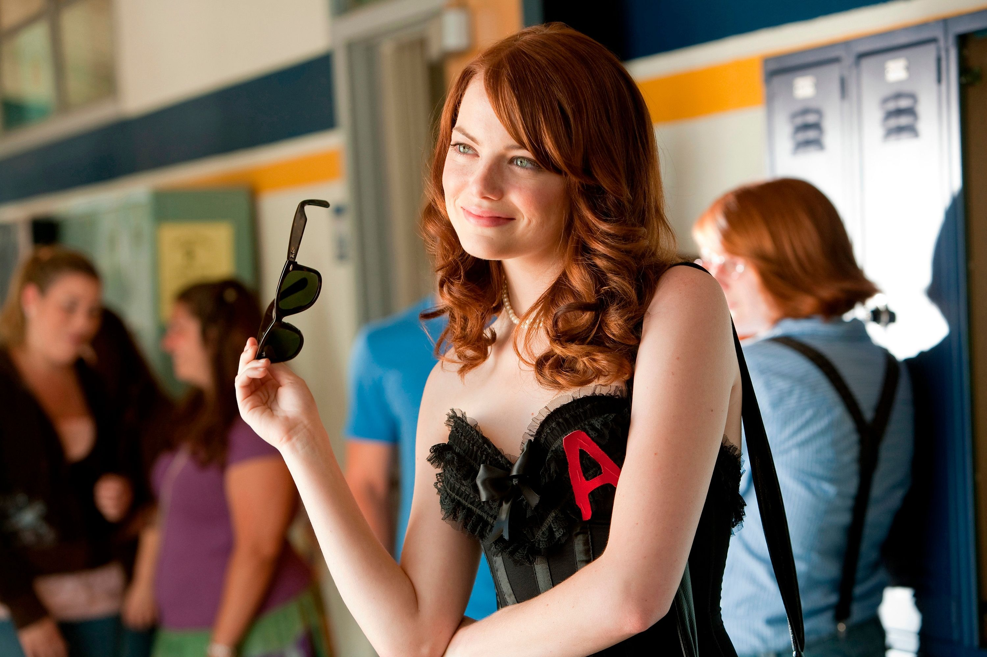
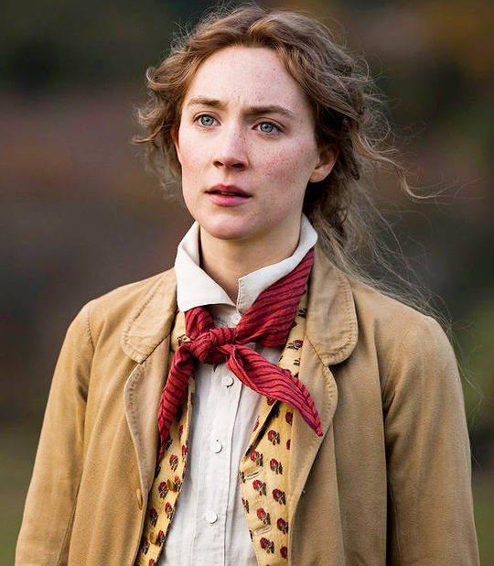


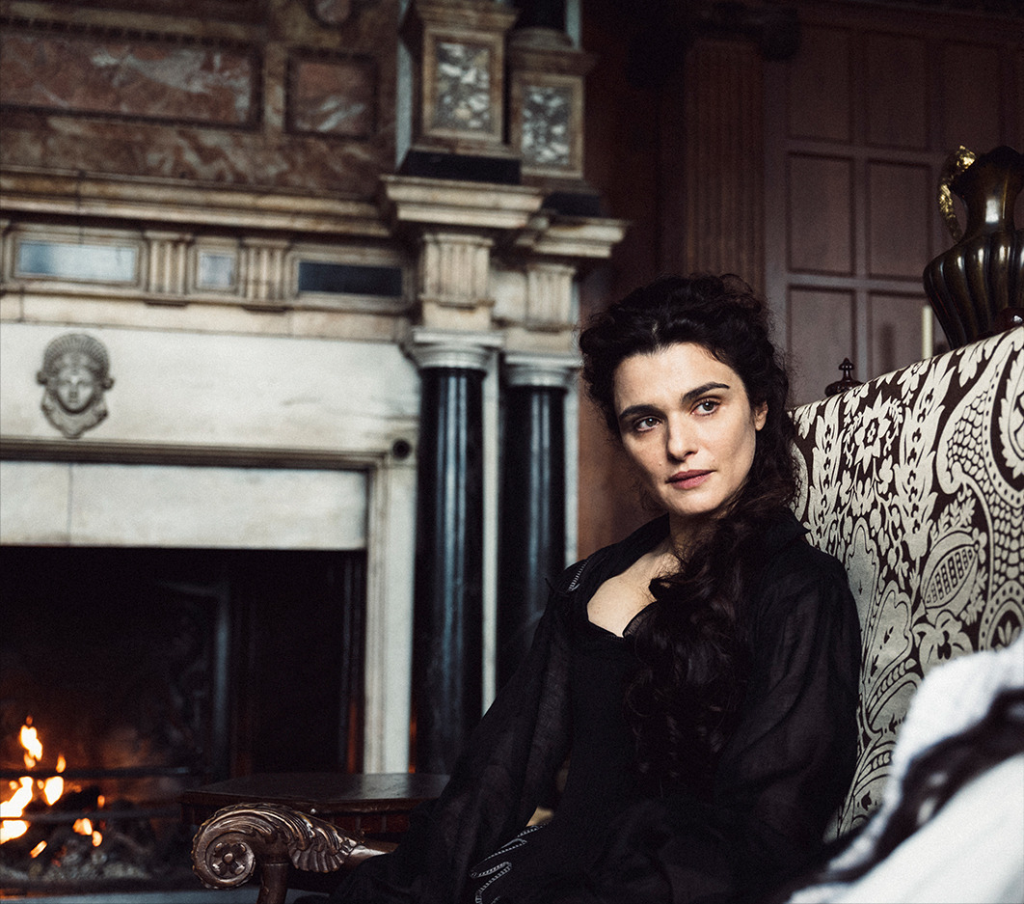


Notes:
Saoirse Ronan: https://saoirseronandaily.tumblr.com/post/188724579660/saoirse-ronan-as-jo-march-in-new-stills-from
Rachel Weisz: https://www.heyalma.com/rachel-weisz-in-the-favourite-is-my-favorite/
Charlize Theron:
https://wall.alphacoders.com/by_sub_category.php?id=171682&name=Aeon+Flux+Wallpapers
Cate Blanchett: http://www.tasteofcinema.com/2015/15-great-movies-with-a-mrs-robinson-complex/

